Slide 1
Building a Rugged DevOps Pipeline using GitHub Actions
Quickly and Easily build a robust pipeline
Notes:
Set UP:
1 - Simple Web with Authorization – use the template repo
2 - Pre-deploy S1
3 - Create Test, Staging and QA slots
4 - PreDeploy SQL Server and set configuration for all slots (simplified and less cost – easy to show that this could be done on different dbs).
5 – PreDeploy actions for open pr to main & push pr to main
6 – Ensure initial migrations
7 – Create a developer resource group for easy cleanup of volatile
[will show demo for push pr to dev]
[will build the volatile push for developer branch]
Must have clean GitHub repo with project already checked in
Need to have one app on the S1 tier to use slots
Need to have prod/qa/staging slots ready
Open PR to Dev -> Volatile dev env, deployed to Azure
Push PR to Dev -> Action to push to test slot at Azure
Open PR to Prod -> Action to push to qa slot at Azure
Push PR to Prod -> Action to deploy to staging
Use the repo template, then create dev branch off of main in the repo
Have database already defined and configured for the staging, qa and production slots

Slide 2
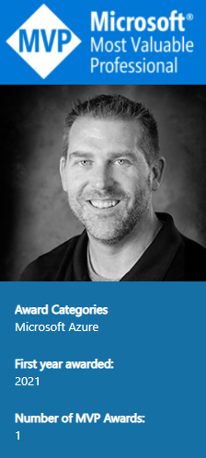
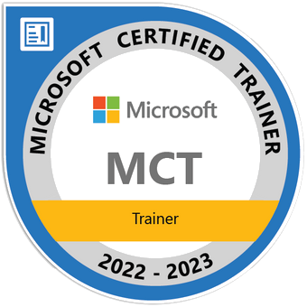


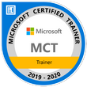
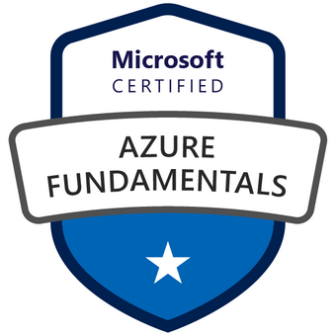
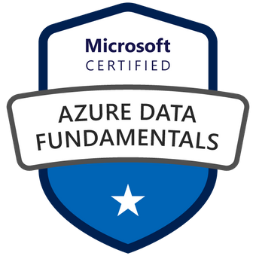
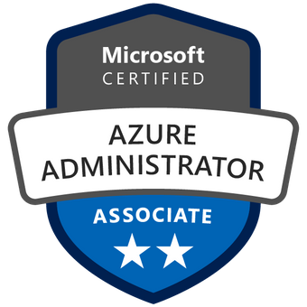
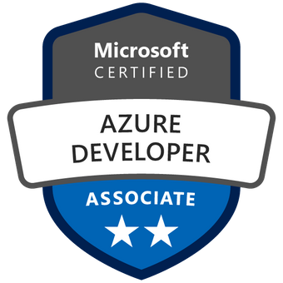
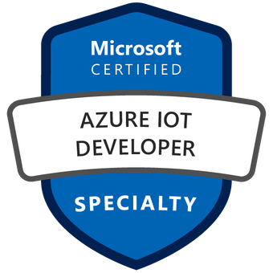
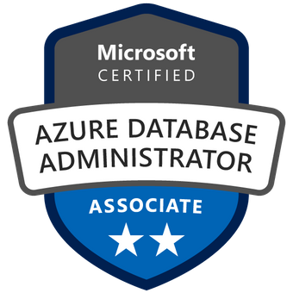
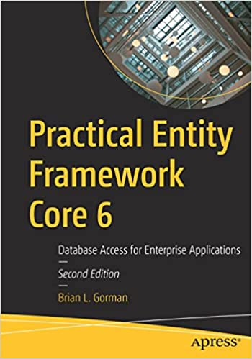
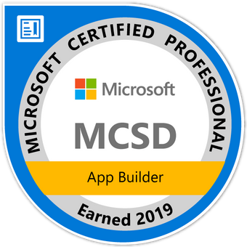
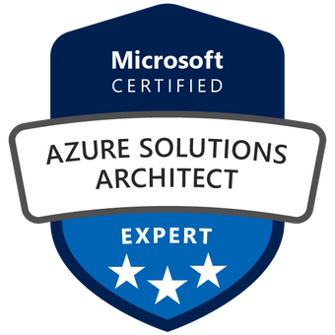
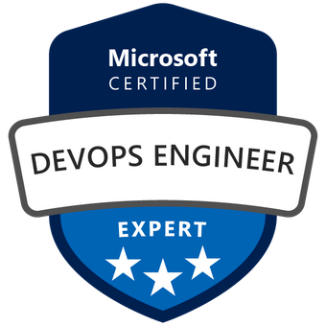

Who am I?
Brian is an experienced speaker, author, trainer, and .Net Developer (~20ish years)
Brian has a masters of science degree in computer information systems, and a bachelor of science degree in computer science. Additionally, Brian has over ten years of experience instructing college courses online in SQL databases, C#/VB .Net programming, Java programming, and Microsoft Office.
Brian has also created many online video courses, available on various platforms. Recently, Brian published his first book: Practical Entity Framework with APress.
Brian is currently a freelance Azure Trainer, running his own company MajorGuidanceSolutions.
Connect with Brian on Twitter and/or Linked In
@blgorman
https://www.linkedin/in/brianlgorman
Notes:
My name is Brian, and I’ll be your presenter for today.
I’ve been working in .Net since it was released to beta in 2001, and have been in various web development positions throughout my career, working with all the tech stacks along the way, including ASP.Net 1 and 2 Webforms, MVC, and am now looking into Blazor and Razor pages as .Net is evolving.
In addition to developing web solutions for many different companies, I have also been teaching in the Computer Science department at Franklin University since 2010 and have been developing training courses since about 2013.
I hold a bachelors in CS from Iowa State and an MS in Computer Information Systems from the UoP. I also have a number of Microsoft certifications that I’ve been earning since 2003 and recently published my first book: Practical Entity Framework with APress (with a second edition for .Net5/EFCore5 currently in progress)
Please follow me for updates and communication on twitter or Linked In. Twitter: blgorman
LinkedIn: brianlgorman

Slide 3
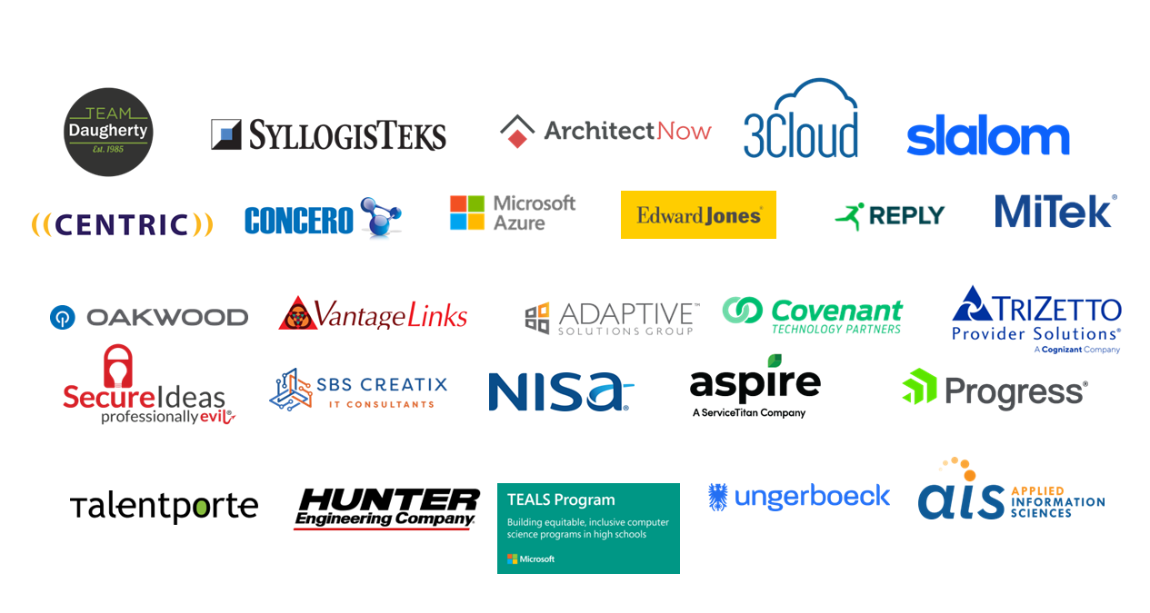

Slide 4
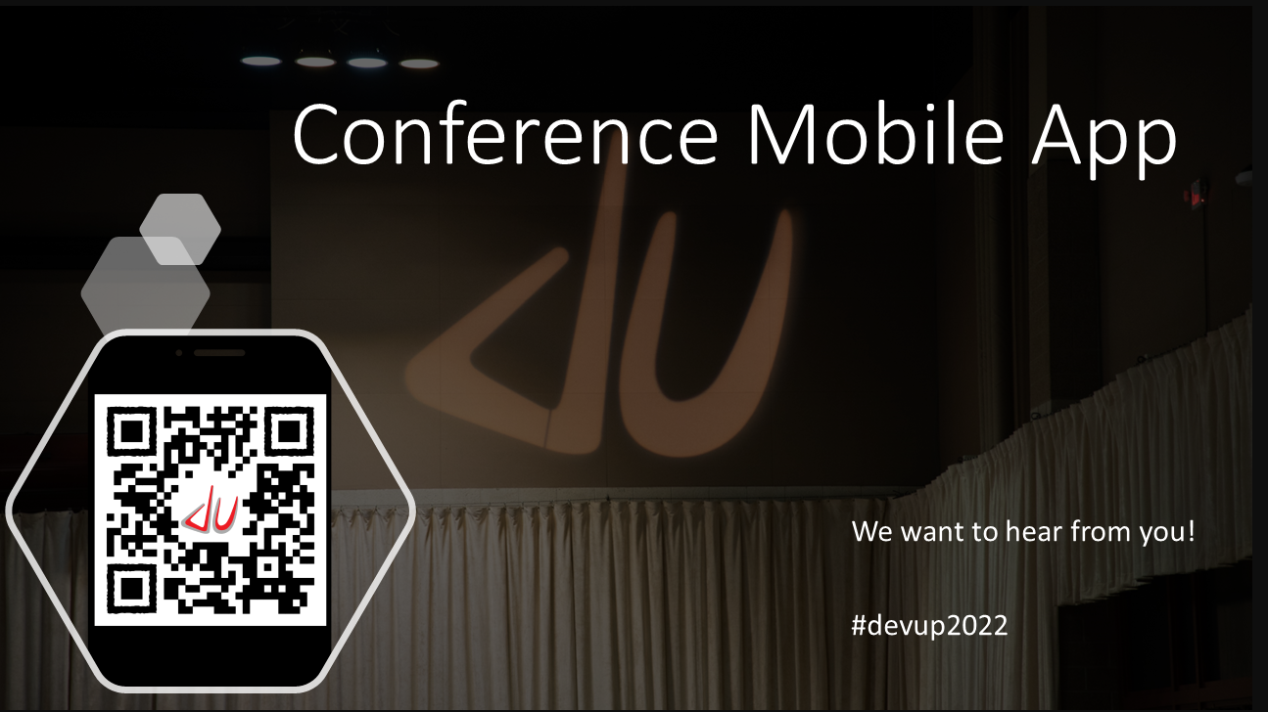

Slide 5
Agenda
Basic Overview of DevOps
Shift-left to move quickly
Create a GitHub Action to build and publish to Azure (publish profile)
Leveraging Infrastructure as Code
Deploying a volatile environment with Actions using Arm Templates
Implementing DevSecOps
Achieving a Rugged DevOps Process
Conclusion
Notes:
Today we’re going to take a look at DevOps and cover some of the basic tenets of what DevOps is and why it’s important. We’ll discuss the key concept of “shifting-left”, and then we’ll dive into some practical examples to illustrate other key concepts of building a robust DevOps pipelines.
Along the way, we’ll also cover how to use secrets in your repositories and then take a brief look at Infrastructure as code and DevSecOps, both of which are worthy of their own talks.
We’ll finish with a pipeline that is robust and shows a good flow through the various stages your team might want to achieve.

Slide 6
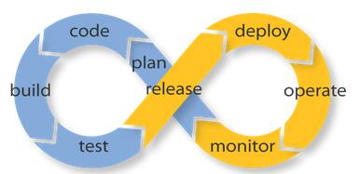
A Basic Overview of DevOps
This Photo by Unknown Author is licensed under CC BY

Slide 7
Discussion
What does Dev Ops mean to you?

Slide 8
DevOps is the union of people, process, and products to enable continuous delivery of value to our end users.
https://www.donovanbrown.com/post/what-is-devops
- Donovan Brown

Slide 9
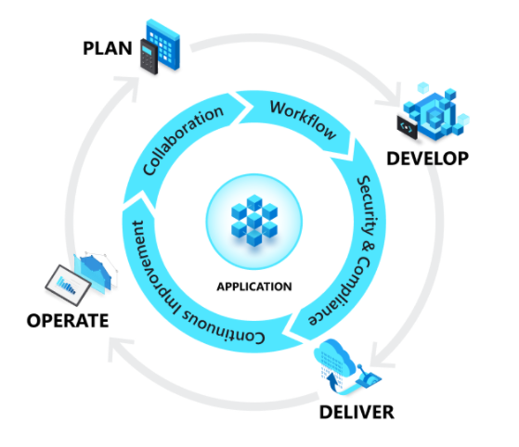
What is DevOps
A Process, NOT a Product [Donovan Brown]
Cycle Time: From Idea to Production
Automated processes
Automated testing
DevSecOps/Rugged [Security]
Gates
Automated/Human
Quality
Release
Image: https://docs.microsoft.com/devops/what-is-devops
Notes:
As stated in the description for this talk, the idea of DevOps is the
Union of people, processes, and technology
The overall goal is to be able to decrease your cycle time while also increasing your confidence
Developers
Quality of Code
Production Release
: No more off-hours/manual deployments

Slide 10
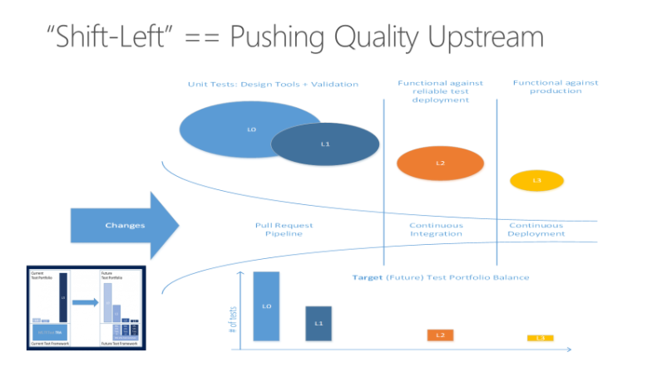
Shift-left
Test as early as possible
Reusable processes
Builds confidence
Reduce Pipeline Execution Time
Ensures Integrity
Design For Testability
https://docs.microsoft.com/en-us/devops/develop/shift-left-make-testing-fast-reliable
Notes:
The main idea of the ‘shift-left’ approach is to move everything as far left as possible.
This means you need to get a lot of buy in from both your upper management and your team members.
You will enforce things like writing unit and integration tests as part of the development process
You will add code scanning to identity bugs and code smells as early as possible (maybe even do something like enforce no warnings)
Additional considerations are using infrastructure as code to create an environment from deployment - helps with configuration drift and ensures settings
You will end up moving much more quickly
You will have developers and ops teams who don’t fear ‘pushing to production’
Your process will not be siloed to the knowledge/capability of a few individuals.

Slide 11
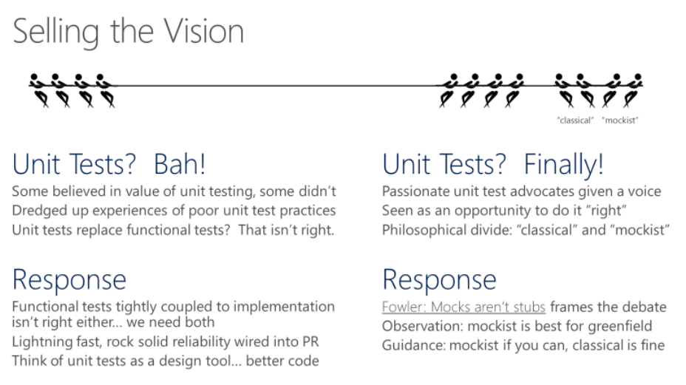
Sell the vision to the team
https://docs.microsoft.com/en-us/devops/develop/shift-left-make-testing-fast-reliable#selling-the-vision-to-the-team

Slide 12
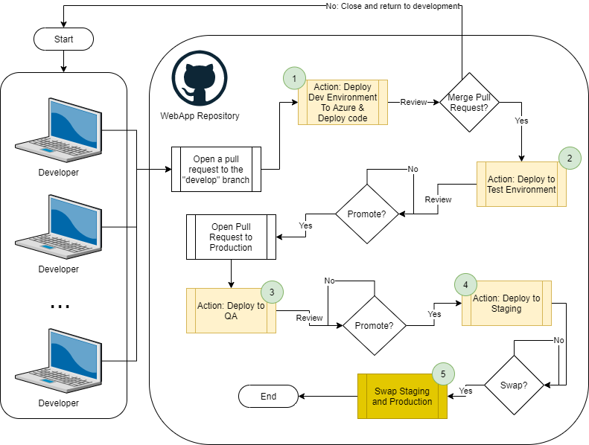
1) Volatile Deployment on PR to develop branch
2) Deploy to Test on Merge code to develop branch
3) Deploy to QA on Open PR to main
4) Deploy to Staging on merge to main
5) Swap to Production from Staging slot

Slide 13
Demo: Use Azure to create a basic pipeline
Notes:
Deploy the application on merge PR to the develop branch
[REMEMBER: Prebuilt includes Web for Prod/Staging/QA/Test. Pre-deployments built for Staging & QA. Only thing left is test. Move to production is a swap operation]
[steps 2, 3, 4 in the diagram all do this the same way, just to different places]
Use the portal to deploy the action
Rename and Modify the action to delete the artifact, show the secret, update with publish profile
Modify the action to include running unit tests

Slide 14

Infrastructure as Code
This Photo by Unknown Author is licensed under CC BY
Automating the deployment of your environment

Slide 15
Why Infrastructure as Code (IaC)
Repeatable results
Eliminate/Minimize Configuration Drift
Quickly and easily deploy a volatile testing environment
Store your configurations in source code
Tools
ARM templates [Bicep]
Terraform
Ansible
Puppet/Chef
Pulumi
Notes:
https://docs.microsoft.com/en-us/azure/azure-resource-manager/templates/deploy-github-actions#generate-deployment-credentials
Remember to mention that we’re focusing on ARM templates

Slide 16
Create the Service Principal (Old Way)
GitHub Actions require a service principal with contributor role access on the resource group
The following command creates a new service principal:
Run as one line from the cloud shell or from a logged-in terminal/bash/powershell
az ad sp create-for-rbac
--name {anything}
--role contributor
--scopes /subscriptions/{your-sub-id}/resourceGroups/{your-rg}
Notes:
NOTE: removed --sdk-auth from the end of the command due to Microsoft Graph changes
This is the old way and it doesn’t work anymore…

Slide 17
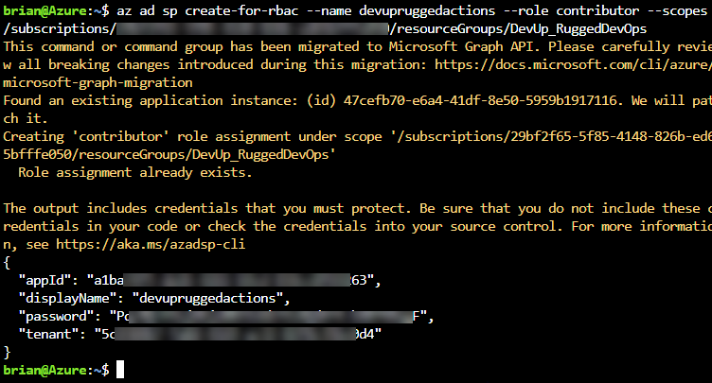
Capture the JSON output

Slide 18
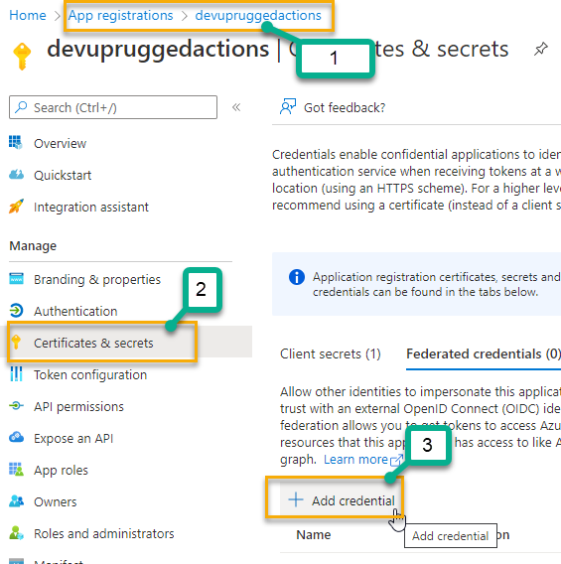
Federated Credentials (new way)
App Registration
Certificates & Secrets
Federated Credentials
Add Credentials
1 for PR
1 for Deployment

Slide 19
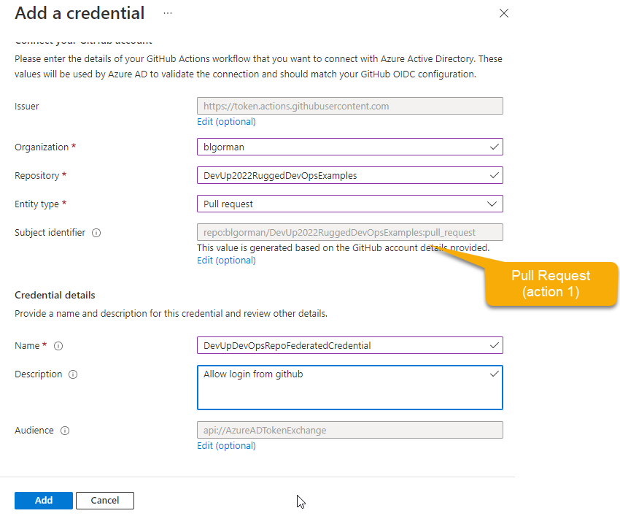

Slide 20
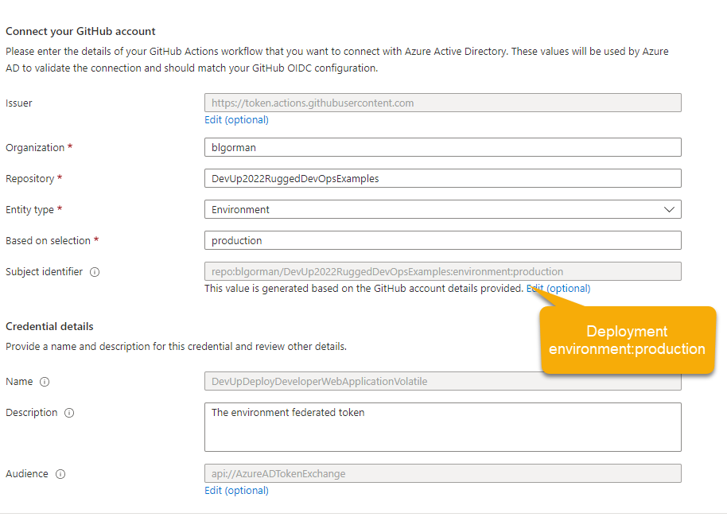

Slide 21
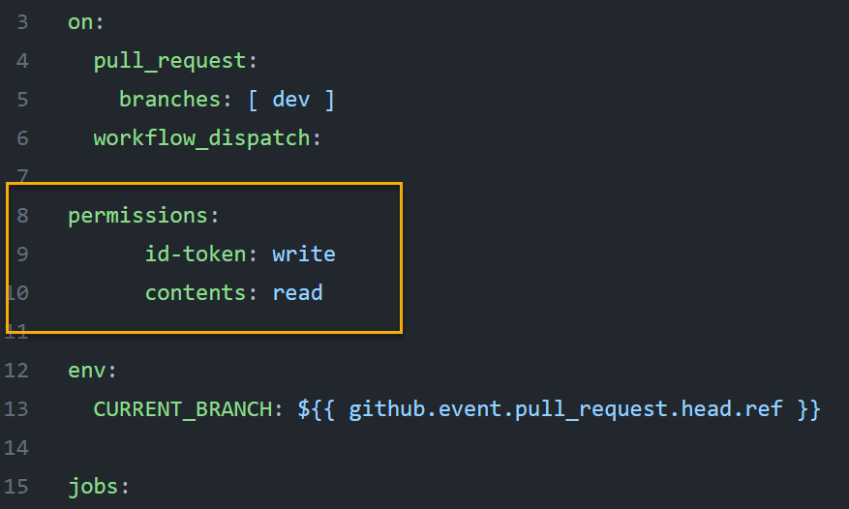
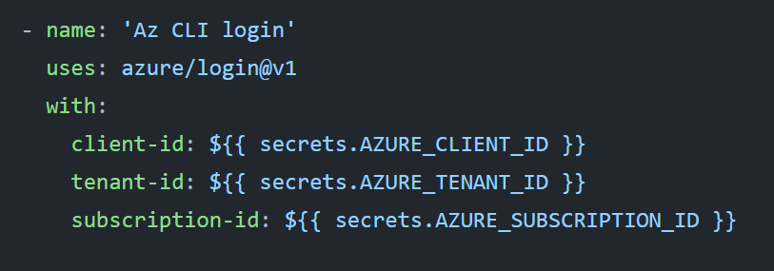
Update the action
Notes:
https://docs.github.com/en/actions/deployment/security-hardening-your-deployments/configuring-openid-connect-in-azure

Slide 22
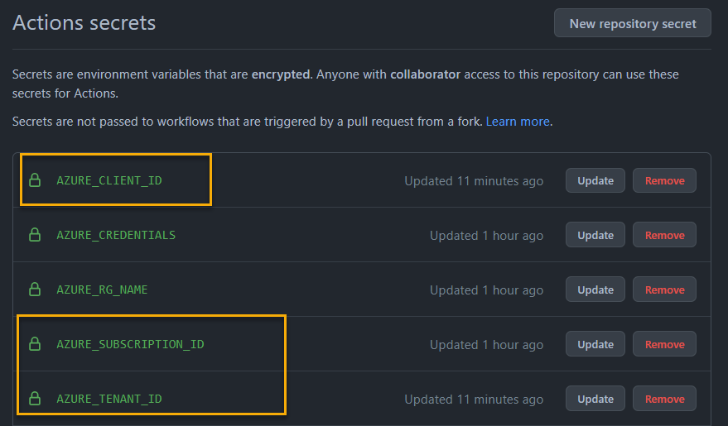
Add appropriate Secrets

Slide 23
Two pipelines
You could do this in one
Shows how to trigger one pipeline from another
Allows re-use of the pipeline at will
Can pass appropriate variables
Pipelines
Deploy Environment (Builds the infrastructure for the developer code)
Deploy Application (Deploys the developer’s version of the code onto new env)

Slide 24
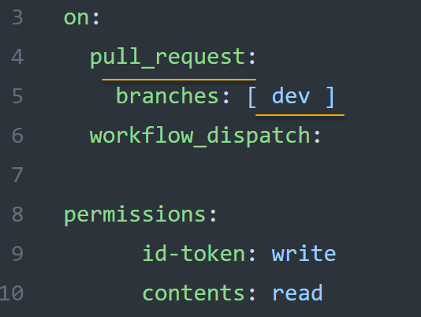
Pipeline 1: Set the trigger for PR to dev

Slide 25
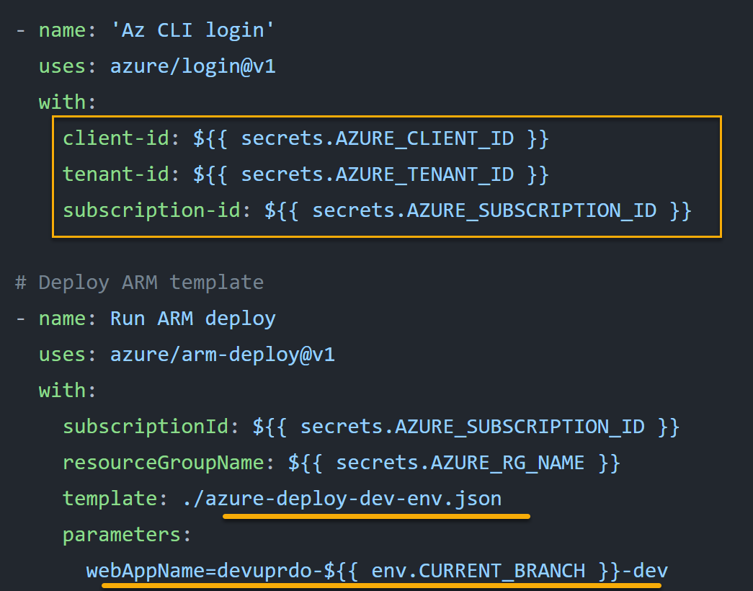
Pipeline 1: Execute the ARM Template
Notes:
Show the Action code here

Slide 26
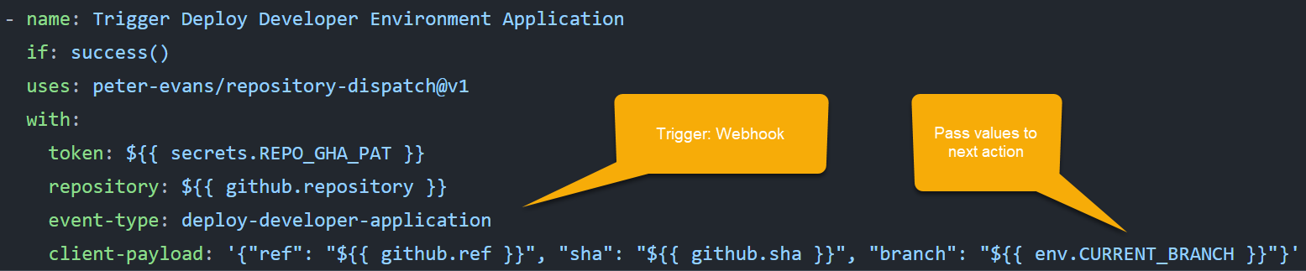
Pipeline 1: Trigger another pipeline [Deploy App]

Slide 27
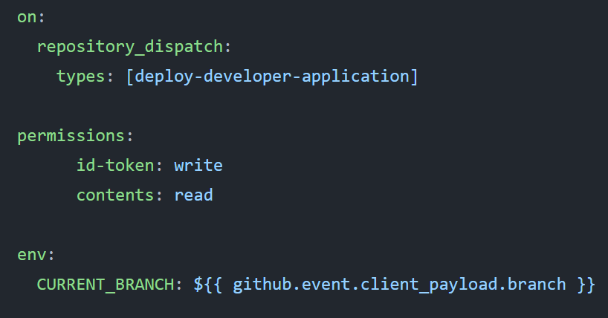
Pipeline 2: Respond to the Trigger

Slide 28
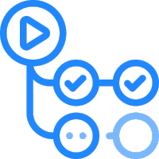
Demo: Show the GitHub action
This Photo by Unknown Author is licensed under CC BY
Creating a volatile environment to test developer changes
Notes:
https://docs.microsoft.com/en-us/azure/developer/github/
https://docs.github.com/en/actions
Use the pre-built actions and just put them in play
https://github.com/marketplace/actions/azure-login
https://docs.github.com/en/actions/deployment/security-hardening-your-deployments/configuring-openid-connect-in-azure

Slide 29

Rugged DevOps and DevSecOps
Security is everyone’s responsibility

Slide 30
Security is everyone's responsibility
Prevent risky deployments
Ensure code quality
Decrease your attack surface where possible
Use proven additional tools
Run lightweight scans in the pipeline
Run deep scans overnight
Use gates/swapping/processes to ensure integrity and confidence for the deployment

Slide 31
Adding Static Code Scanning to your pipeline

Slide 32
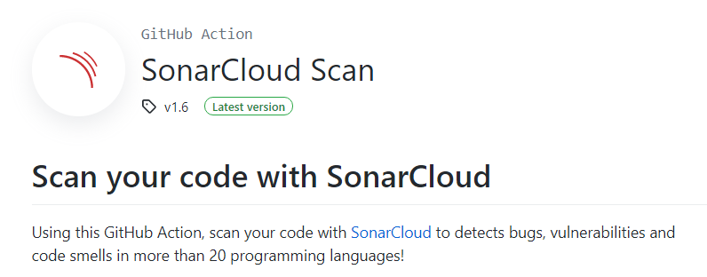
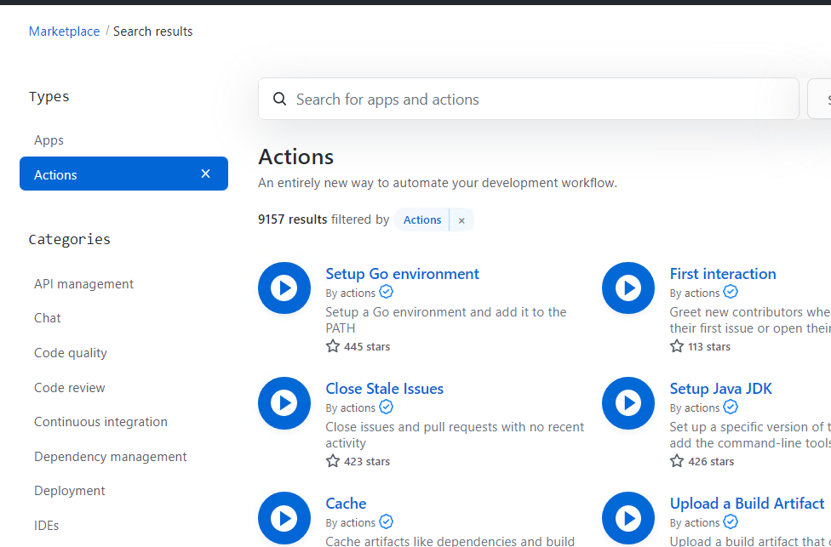
GitHub Marketplace
Notes:
https://github.com/marketplace
https://github.com/marketplace/actions/sonarcloud-scan

Slide 33
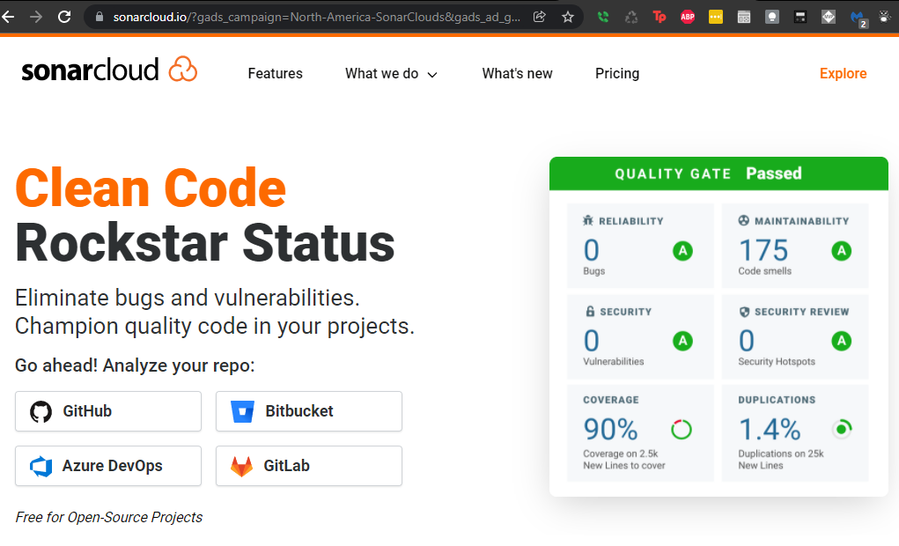

Slide 34
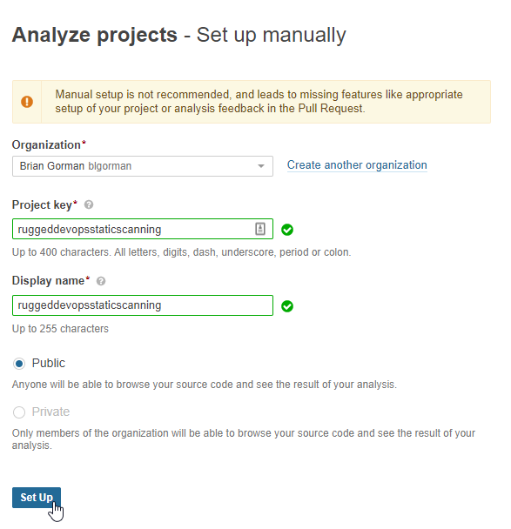

Slide 35
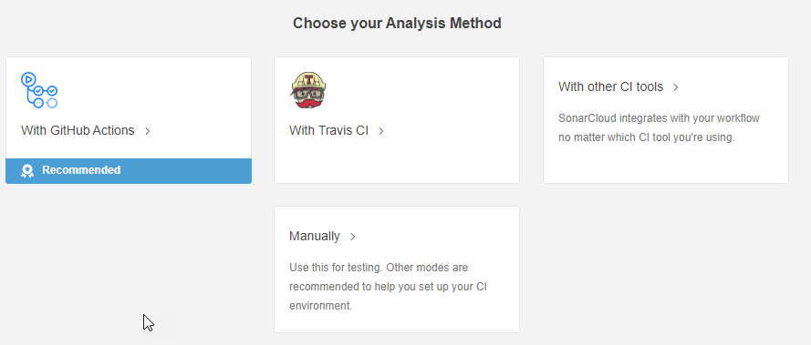
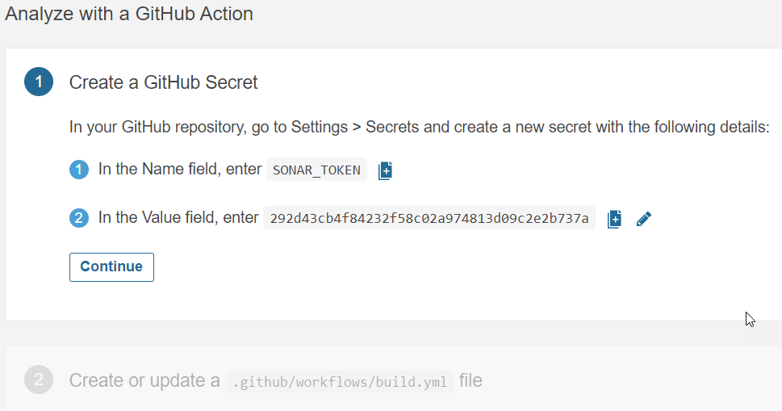

Slide 36
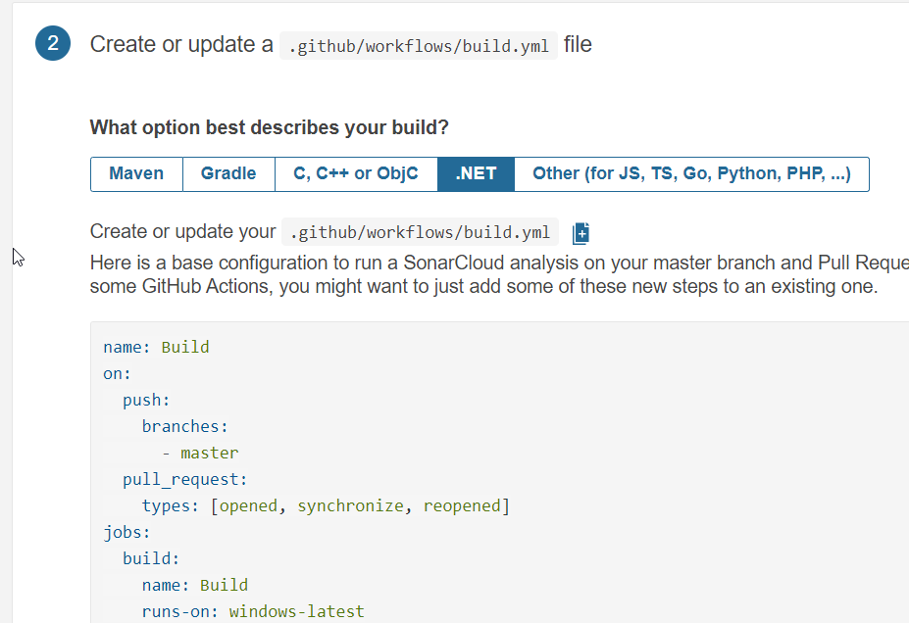
Notes:
Take what is there but modify it to have the .Net 6 framework

Slide 37
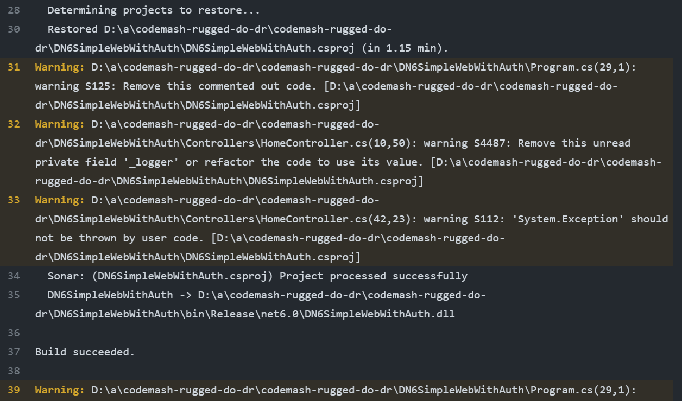

Slide 38
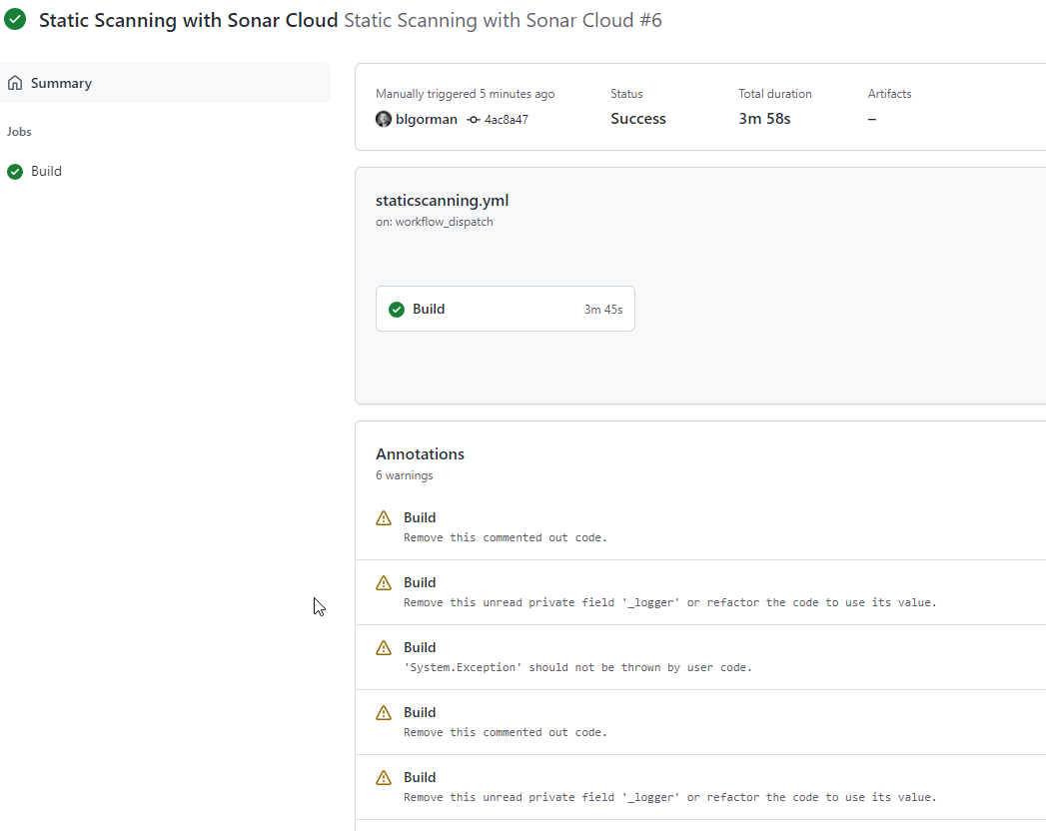

Slide 39
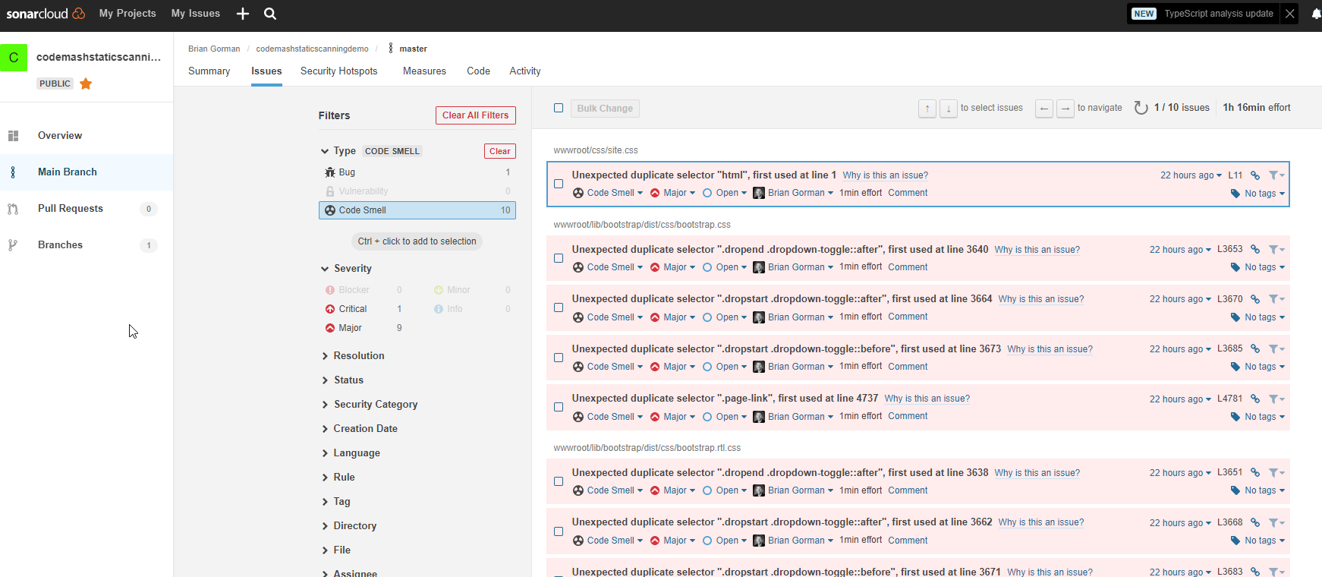
SonarCloud Static Code Scanning
https://sonarcloud.io/github
https://sonarcloud.io/project/issues?id=codemashstaticscanningdemo&resolved=false&types=CODE_SMELL

Slide 40
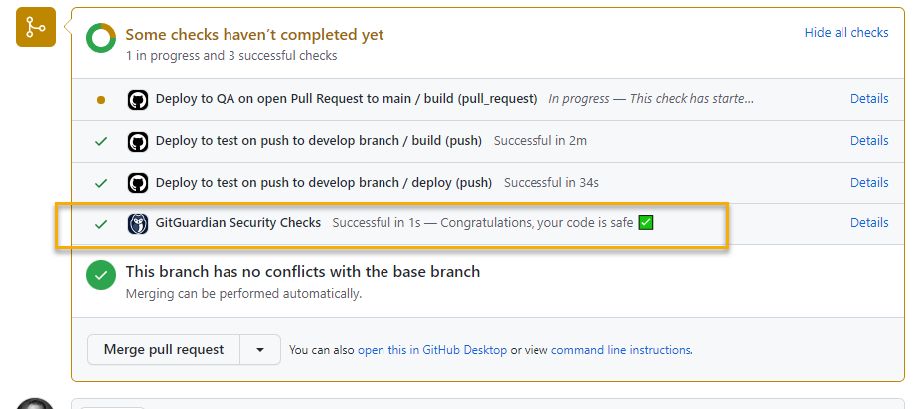
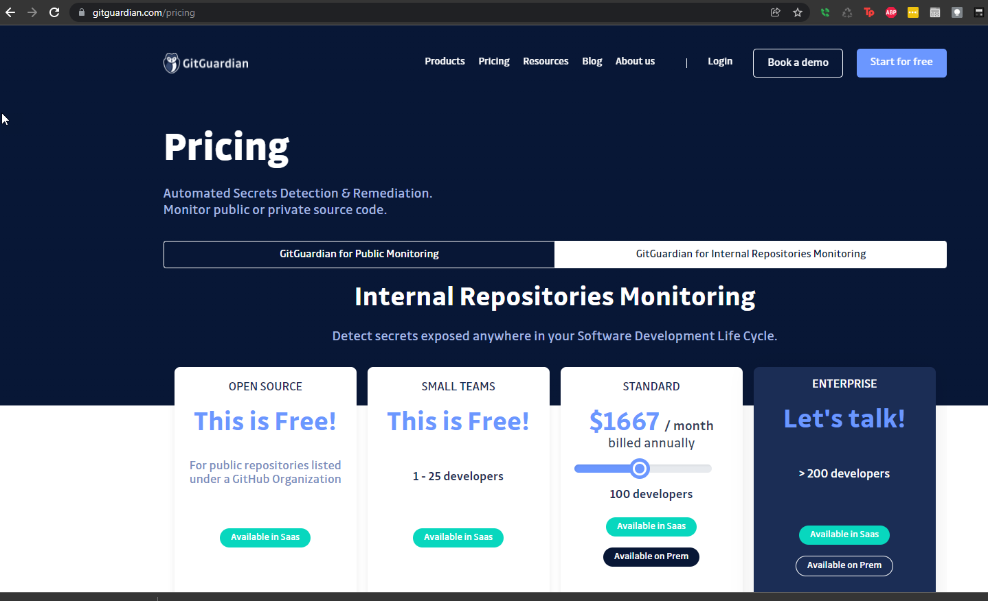
Git Guardian
https://www.gitguardian.com

Slide 41
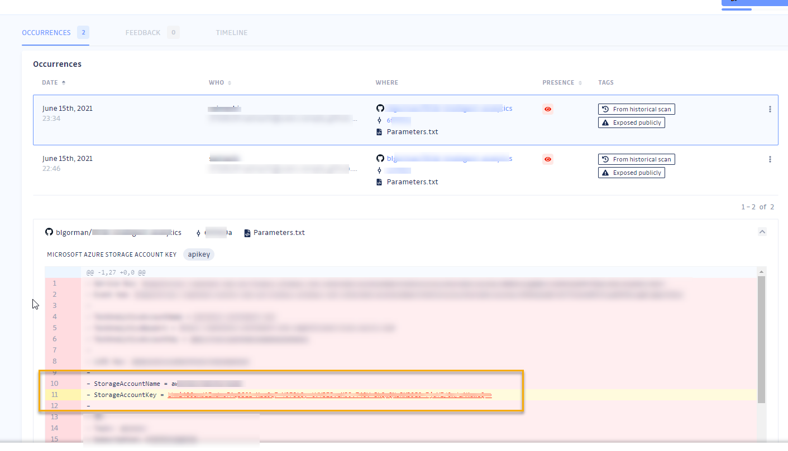
Notes:
Identified a publicly-exposed azure storage account key

Slide 42
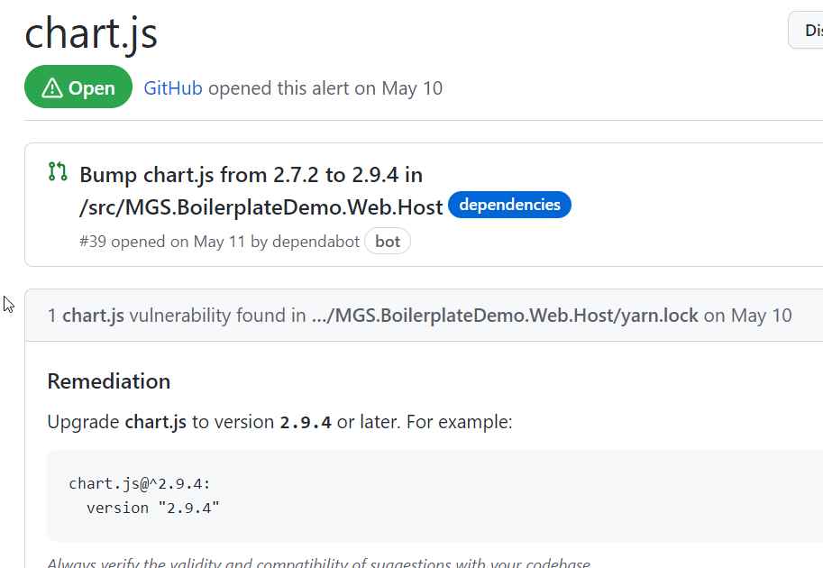
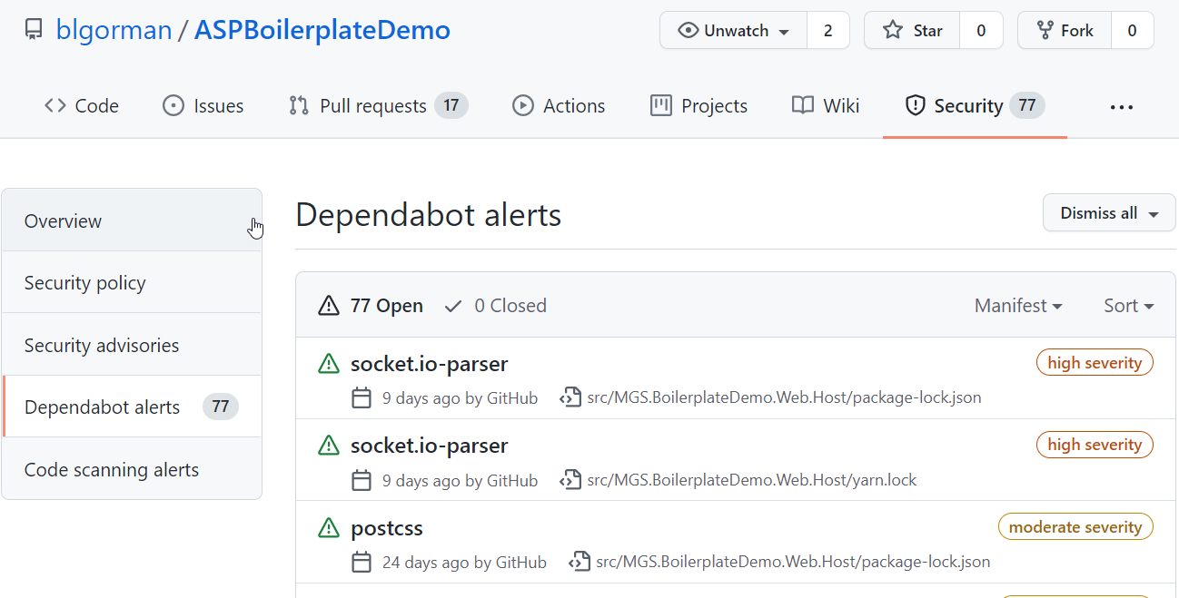
Dependabot

Slide 43
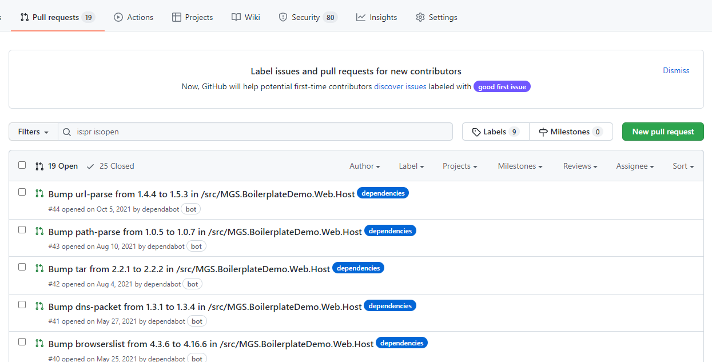
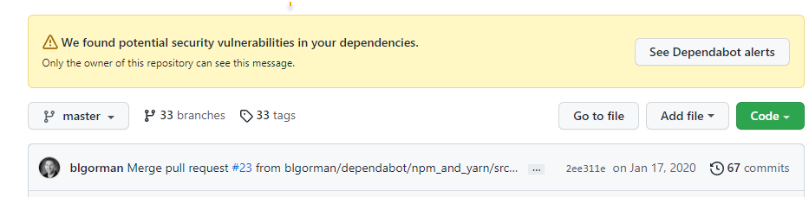
Dependabot
https://github.com/dependabot

Slide 44
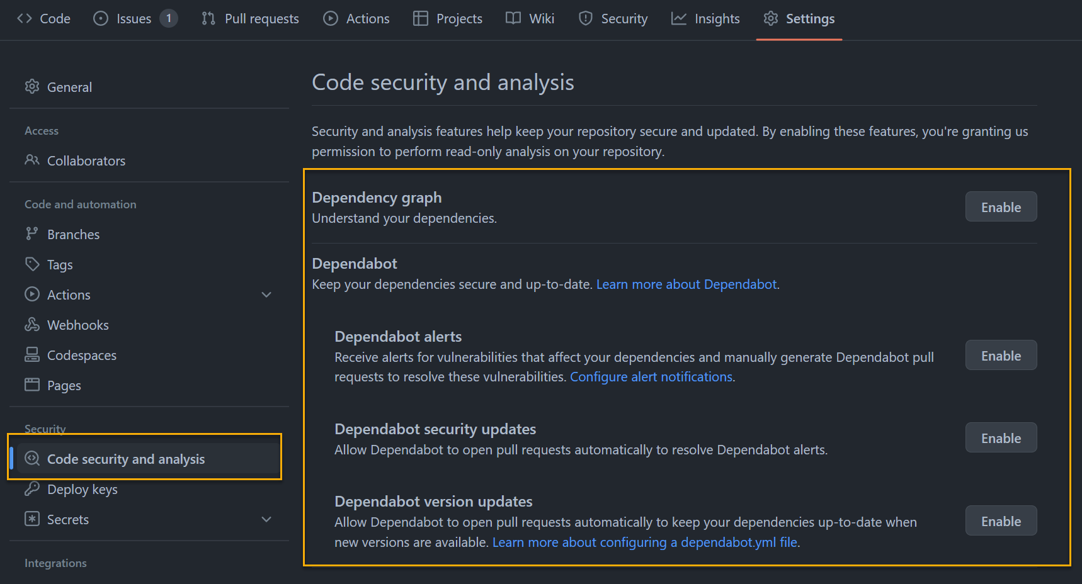

Slide 45

Penetration Testing
Notes:
https://github.com/marketplace?type=actions&query=owasp+zap+

Slide 46


Slide 47

Notes:
https://github.com/zaproxy/action-baseline

Slide 48

Issues raised by Zap Scan

Slide 49

WhiteSource Package, Licensing, and Dependencies

Slide 50

WhiteSource Bolt

Slide 51


Slide 52


Slide 53


Slide 54

GitHub Security – Dependency Review

Slide 55

Achieving a robust DevOps process
This Photo by Unknown Author is licensed under CC BY

Slide 56

6) Static Code Scanning
7) Static Code Scanning, Dependency Scanning
8) Light Pen Testing
9) Deep Pen Testing [Nightly]

Slide 57
Final thoughts around DevOps
NO SECRETS IN YOUR CODE
No long-running branches
Use a git-flow-ish branching strategy
Main -> Dev -> Feature/Developer
Large teams consider using a forking strategy
Integration Manager
Dictator and Lieutenants
If possible, do not rebuild artifacts throughout the pipeline
Do not allow anyone to manipulate an artifact manually

Slide 58
Summary
DevOps is a team effort that requires buy-in and commitment from everyone
Protect and use secrets when possible
Implement infrastructure as code
DevSecOps
Achieve a Robust pipeline

Slide 59

Questions?
Email:
brian@majorguidancesolutions.com
Twitter
@blgorman
Linked In
https://www.linkedin/in/brianlgorman
Repo
https://github.com/blgorman/DevUp2022RuggedDevOpsExamples

Slide 60

Conclusion
@blgorman
https://www.linkedin.com/in/brianlgorman
https://training.majorguidancesolutions.com
https://open.spotify.com/artist/0rRlrvBVhAhZCHcENoiFJ0
Enjoy the rest of your conference!
Notes:
Thank you for attending my talk today. Please reach out and connect.
If you liked the talk today, you can support me by listening to one or more of my songs on spotify ☺
Enjoy the rest of your conference!

